Slide 1
Build Your Own AI Pipeline and Let It Draft Your Test Plan
Tine Starič | Companial | Microsoft MVP Luc van Vugt | fluxxus.nl | 4PS | Microsoft MVP

Slide 2
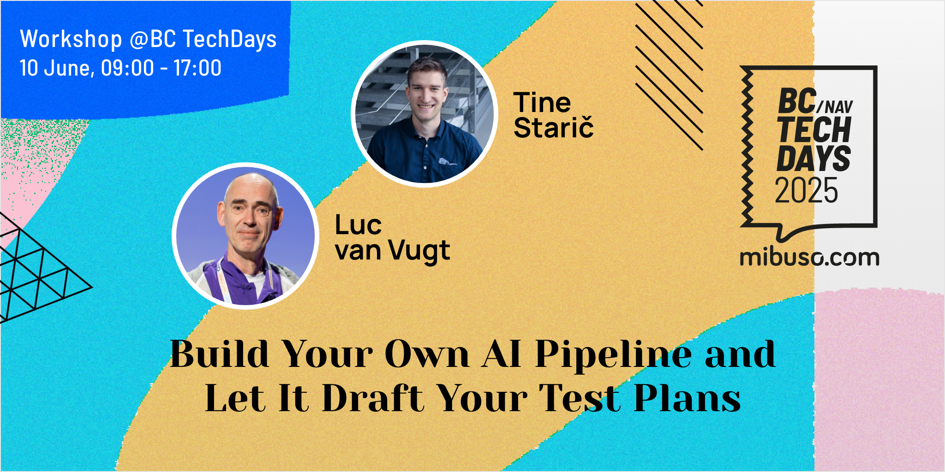
Build Your Own AI Pipeline and Let It Draft Your Test Plan

Slide 3



Owner @fluxxus.nl
QA Lead @4PS
Microsoft MVP since 2011
Almost bold dinosaur kept evolving by juniors
Struck by test automation for more than a decade
Founder Areopa webinars

Slide 4


Strategist @Companial
Microsoft MVP for about a year
Test Automation Enthusiast
AI-obsessed

Slide 5
This workshop is being recorded

Slide 6
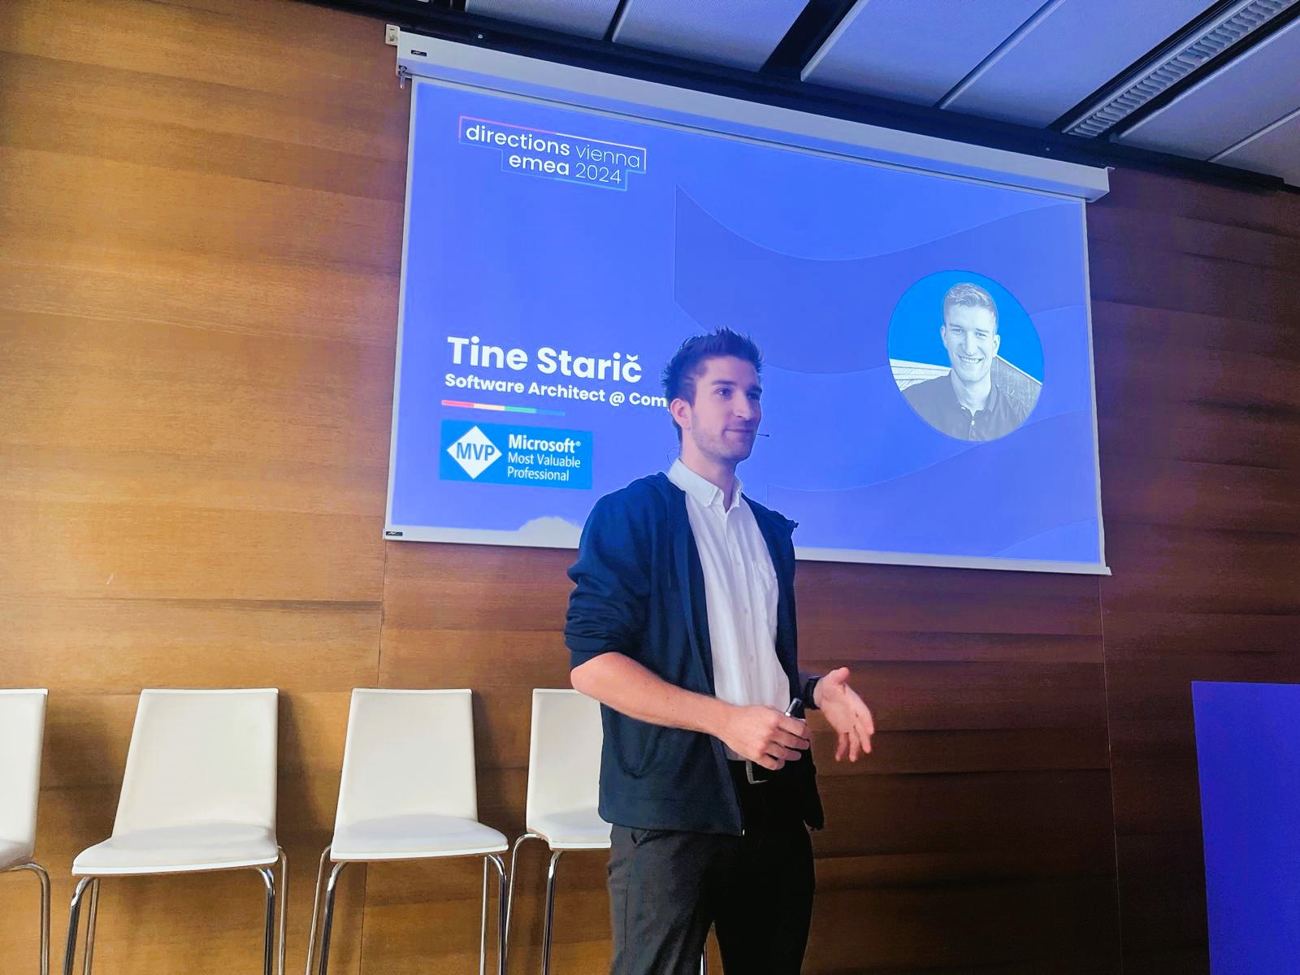
This journey started here …
… in Tine’s Directions EMEA 2024 session How to be a Prompt Engineer
Notes:
In this session, in a very enthusing and simple way, Tine showed how to create efficient and effective system prompts to ask AI to get something done.

Slide 7
Time | Topic | Format
08:00–09:00 | Registration & Coffee | Arrival, Setup
09:00–09:30 | Welcome + Why Test Plans Matter + Workshop Goals | Talk
09:30–10:00 | Step 1: Try Prompting on Your Own (Cold Prompt) | Hands-on
10:00–10:45 | Step 2: Add Structure to Your Prompt | Lecture + Hands-on
10:45–11:00 | ☕ Coffee Break – Is prompting easy or hard? | Free roam
11:00–11:30 | Step 3: Use System Prompt Generator | Tool Walkthrough
11:30–12:20 | Step 4 & 5: Peer Feedback (ATDD Lens) + Improve Prompt | Pair Exercise
12:20–13:20 | 🍽️ Lunch – How did peer feedback change your perspective? | Break
13:20–14:00 | Step 6: Try Different Models | Hands-on + Group Debrief
14:00–14:45 | Step 7: Prompt for Reasoning Models | Lecture + Prompting
14:45–15:00 | ☕ Coffee Break – Which models did you like best? | Stretch + Chat
15:00–15:45 | Step 8: Manual Pre/Postprocessing | Guided + Solo Work
15:45–16:30 | Step 9: Multi-Model Pre/Postprocessing – Build Your Pipeline | Build Time
16:30–17:00 | Wrap-up: Demos, Reflections, What's Next | Group Share + Closing

Slide 8
Goal
Learn and develop ourselves
Share our findings
Illustrate how AI can be your companion
Lower the threshold for using Test Plans
… of this session.

Slide 9
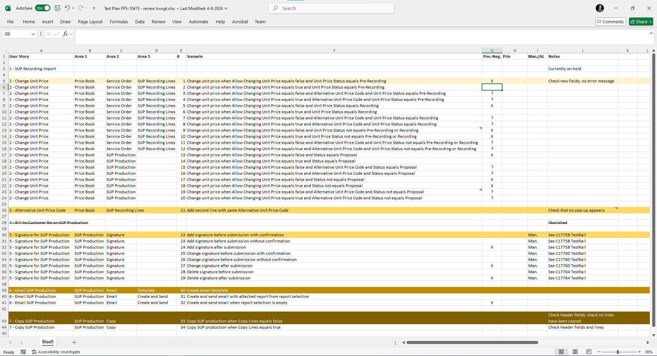
What is a Test Plan?
… and why it matters for software quality

Slide 10
What is a Test Plan?
List of (all) user scenarios that defines
what we enable the user to do
the different behaviors of what we build and should validate
in other words, the set of test scenarios to be used for this validation
As such it’s an inseparable twin with the requirements

Slide 11

Why a Test Plan?
By setting up a Test Plan (TP) before any coding is done…
… it turns out requirements are more and better challenged
It’s a great help in getting a buy-in from the whole development team
It altogether drives the quality of our software

Slide 12

What is a Test Plan?
Some notes
Scenarios should cover both sunny and rainy paths
aka positive and positive-negative tests
Scenarios are user actions and do not focus yet on pre- and postconditions

Slide 13

Test Plan Example

Slide 14
Test Plan Example

Slide 15
Test Plan Example
Functional Area

Slide 16
Test Plan Example
Scenario Id

Slide 17
Test Plan Example
Scenario Description

Slide 18
Test Plan Example
Positive-Negative

Slide 19

More on Test Plan
Areopa webinar – November 17, 2020
My requirements specification - all facing the same direction
Areopa webinar – July 19, 2022
Test Automation is a team effort
Areopa webinar – September 16, 2024
On lightning-fast test automation, SOLIDized code and a revised test plan

Slide 20

Test Plan challenge

Slide 21
Test Plan challenge
Time consuming
Reviewing and conceiving at the same time can be conflicting
A kind of emotional threshold
How to describe?
Often seems an “endless” list
How to do this when I have nothing at hand yet?

Slide 22
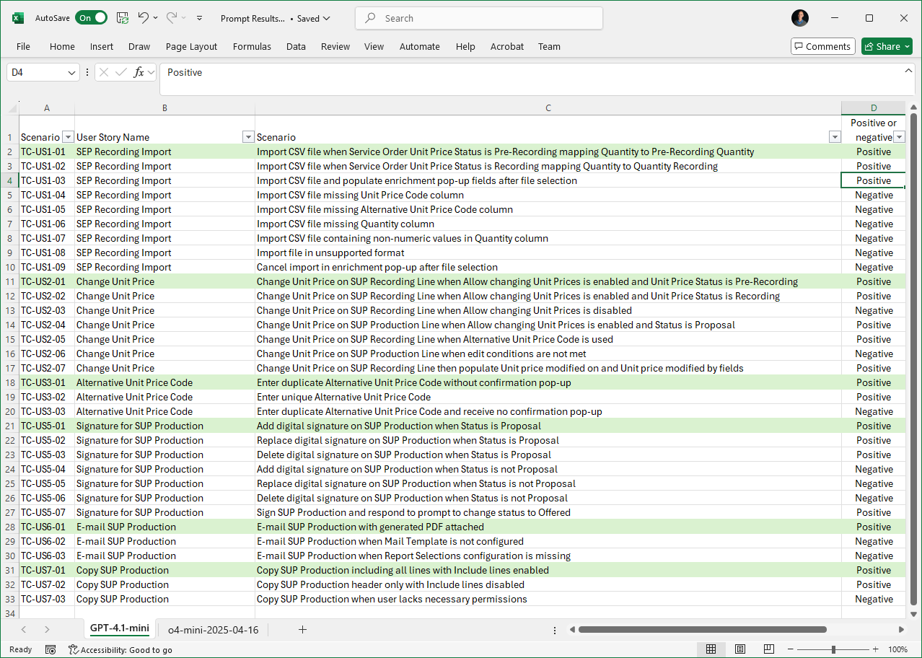

Notes:
Step-by-step AI-assisted test plan creation
Refining prompts for better results
Comparing different AI models in action

Slide 23
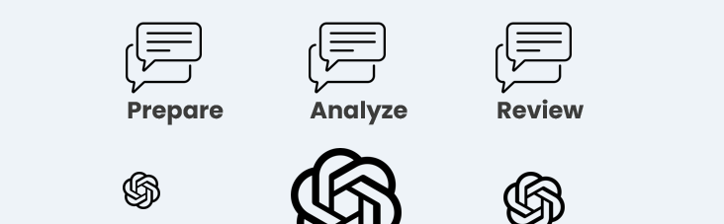
How AI can help
… instead of just generating emails 😉

Slide 24
Time | Topic | Format
08:00–09:00 | Registration & Coffee | Arrival, Setup
09:00–09:30 | Welcome + Why Test Plans Matter + Workshop Goals | Talk
09:30–10:00 | Step 1: Try Prompting on Your Own (Cold Prompt) | Hands-on
10:00–10:45 | Step 2: Add Structure to Your Prompt | Lecture + Hands-on
10:45–11:00 | ☕ Coffee Break – Is prompting easy or hard? | Free roam
11:00–11:30 | Step 3: Use System Prompt Generator | Tool Walkthrough
11:30–12:20 | Step 4 & 5: Peer Feedback (ATDD Lens) + Improve Prompt | Pair Exercise
12:20–13:20 | 🍽️ Lunch – How did peer feedback change your perspective? | Break
13:20–14:00 | Step 6: Try Different Models | Hands-on + Group Debrief
14:00–14:45 | Step 7: Prompt for Reasoning Models | Lecture + Prompting
14:45–15:00 | ☕ Coffee Break – Which models did you like best? | Stretch + Chat
15:00–15:45 | Step 8: Manual Pre/Postprocessing | Guided + Solo Work
15:45–16:30 | Step 9: Multi-Model Pre/Postprocessing – Build Your Pipeline | Build Time
16:30–17:00 | Wrap-up: Demos, Reflections, What's Next | Group Share + Closing

Slide 25
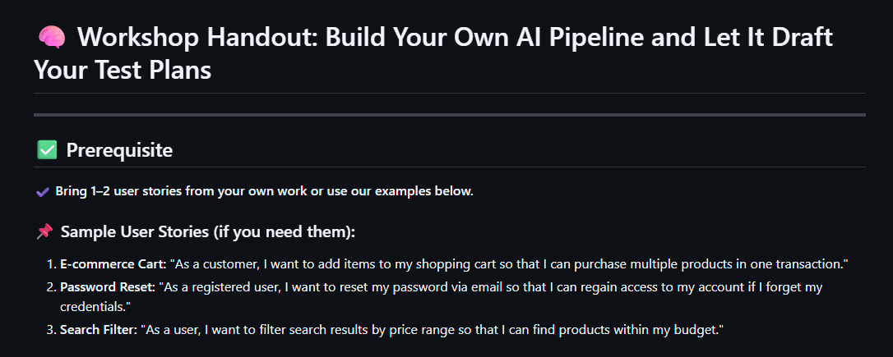
Workshop material share
https://github.com/tinestaric/AI4TestPlans

Slide 26
Step 1 – Try on Your Own (Cold Prompt)
https://github.com/tinestaric/AI4TestPlans/blob/main/Handout.md
Prompt Engineering Workshop · Streamlit

Slide 27
Time | Topic | Format
08:00–09:00 | Registration & Coffee | Arrival, Setup
09:00–09:30 | Welcome + Why Test Plans Matter + Workshop Goals | Talk
09:30–10:00 | Step 1: Try Prompting on Your Own (Cold Prompt) | Hands-on
10:00–10:45 | Step 2: Add Structure to Your Prompt | Lecture + Hands-on
10:45–11:00 | ☕ Coffee Break – Is prompting easy or hard? | Free roam
11:00–11:30 | Step 3: Use System Prompt Generator | Tool Walkthrough
11:30–12:20 | Step 4 & 5: Peer Feedback (ATDD Lens) + Improve Prompt | Pair Exercise
12:20–13:20 | 🍽️ Lunch – How did peer feedback change your perspective? | Break
13:20–14:00 | Step 6: Try Different Models | Hands-on + Group Debrief
14:00–14:45 | Step 7: Prompt for Reasoning Models | Lecture + Prompting
14:45–15:00 | ☕ Coffee Break – Which models did you like best? | Stretch + Chat
15:00–15:45 | Step 8: Manual Pre/Postprocessing | Guided + Solo Work
15:45–16:30 | Step 9: Multi-Model Pre/Postprocessing – Build Your Pipeline | Build Time
16:30–17:00 | Wrap-up: Demos, Reflections, What's Next | Group Share + Closing

Slide 28


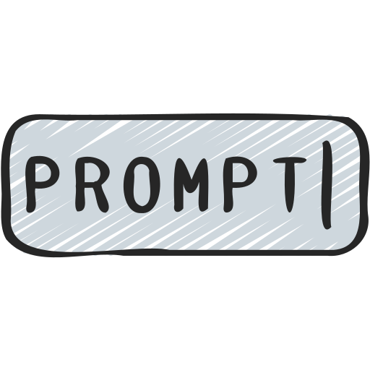





How to be a Prompt Engineer

Slide 29


How to be a Prompt Engineer

Slide 30
How to be a Prompt Engineer
You are a tool that extracts project backlog items from given texts.
If there are any quotes change them to single quotes.
You should read whole text and extract array of backlog items in JSON format from it.

Slide 31
Build prompts with structure and examples
Instructions
Steps
Format Requirements
Examples
Notes
Notes:
Re-itteration
English speakers are better off

Slide 32


Few-shot learning
Don’t only tell the model what you want, show the model how you want it
Add 50 units of Item A and 100 units of Item B to the purchase order.
Please extract the items mentioned in the following text that the user wants to add to the purchase order and return them in JSON format.

Slide 33
Few-shot learning
Don’t only tell the model what you want, show the model how you want it
Add 50 units of Item A and 100 units of Item B to the purchase order.
Extract the items a user specifies they want to add to a purchase order in the ERP and return them in JSON format. Here are some examples:
Example 1: Text: 'Please add 30 units of Item X, 10 units of Item Y, and 5 units of Item Z to the purchase order.' Output:
{ "items": [ { "name": "Item X", "quantity": 30 }, { "name": "Item Y", "quantity": 10 }, { "name": "Item Z", "quantity": 5 } ] }
Example 2: Text: 'Include 15 units of Part A and 25 units of Part B in the order.' Output:
{ "items": [ { "name": "Part A", "quantity": 15 }, { "name": "Part B", "quantity": 25 } ] }

Slide 34
Examples
# Examples
**Example 1: User Requirement Document**
- Input: [Provide summary or key parts of the document]
- JSON Output:
```json
{
"title": "[Title extracted from document]",
"description": "[A comprehensive description extracted from the document.]",
"acceptanceCriteria": "[List of acceptance criteria extracted from the document.]",
"priority": "[Priority level, if provided.]"
}
```
**Example 2: Bug List**
- Input: [Summary or key details of the bug]
- JSON Output:
```json
{
"title": "[Bug title]",
"description": "[Detailed bug description]",
"acceptanceCriteria": "[Criteria for resolution]",
"priority": "[Priority level (e.g., critical, high, medium, low)]"
}
```
**Example 3: Use Case Document**
- Input: [Summary or key parts of the use case]
- JSON Output:
```json
{
"title": "[Use case title]",
"description": "[Detailed description of the use case]",
"acceptanceCriteria": "[Acceptance criteria derived from the use case]",
"priority": "[Priority level, if applicable]“
}
```

Slide 35
Chain of Thought
Give the model time to think
Determine if a discount of 12% can be approved for an order value of $8,000
Determine if a requested discount can be approved based on order value.
value > 10k – max discount 15%
5k < value < 10k – max discount 10%
value < 5k – max discount 5%

Slide 36
Chain of Thought
Give the model time to think
Determine if a discount of 12% can be approved for an order value of $8,000
Determine if a requested discount can be approved based on order value.
value > 10k – max discount 15%
5k < value < 10k – max discount 10%
value < 5k – max discount 5%
Follow these steps to reach the decision:
Identify the Order Value: Check the order value provided.
Determine the Discount Threshold: Based on the order value, decide the maximum allowable discount.
Compare Discount with Threshold: Check if the requested discount is within the allowable limit.
Make a Decision: If the requested discount is within the allowable limit, approve the request; otherwise, reject it.

Slide 37
Chain of Thought
Give the model time to think
# Steps
1. **Read and Understand the Input**: Analyze the user's input document to identify key components related to backlog items.
2. **Identify Key Components**:
- **Title**: Determine the overarching title or main topic.
- **Description**: Extract a detailed description of the item.
- **Acceptance Criteria**: Define what constitutes successful completion.
- **Priority**: Identify the priority level if provided.
- **Additional Information**: Gather any other relevant details such as status, assignee, or dependencies.
3. **Structure Information**: Organize identified information into a JSON format, ensuring each field is correctly labeled and populated.

Slide 38
Prompt Reinforcement/Anchoring
Remind the model what you want
Determine if a requested discount can be approved based on order value.
value > 10k – max discount 15%
5k < value < 10k – max discount 10%
value < 5k – max discount 5%
Follow these steps:
Identify the Order Value
Determine the Discount Threshold
Compare Discount with Threshold
Make a Decision
Notes:
Ensure that the requested discount is compared with the maximum allowable discount for the specified order range.
Follow each rule carefully and evaluate both the order value and requested discount before making a decision.
Provide a clear final decision as either ‘Approve’ or ‘Reject’.

Slide 39
Build prompts with structure and examples
Instructions
Steps
Format Requirements
Examples
Notes
Notes:
Re-itteration
English speakers are better off

Slide 40
Build prompts with structure and examples
You are a tool that extracts project backlog items from given texts.
If there are any quotes change them to single quotes.
You should read whole text and extract array of backlog items in JSON format from it.

Slide 41
Build prompts with structure and examples
Extract information from requirement documents, bug lists, or use cases and convert it into a JSON format suitable for backlog items.
- Analyze the input document for relevant information such as titles, descriptions, acceptance criteria, and priorities.
- Structure the extracted data into a JSON format that aligns with backlog item conventions, ensuring all necessary fields are included.
# Steps
1. **Read and Understand the Input**: Analyze the user's input document to identify key components related to backlog items.
2. **Identify Key Components**:
- **Title**: Determine the overarching title or main topic.
- **Description**: Extract a detailed description of the item.
- **Acceptance Criteria**: Define what constitutes successful completion.
- **Priority**: Identify the priority level if provided.
- **Additional Information**: Gather any other relevant details such as status, assignee, or dependencies.
3. **Structure Information**: Organize identified information into a JSON format, ensuring each field is correctly labeled and populated.
# Output Format
The output should be in JSON format, including but not limited to the following fields:
- `title`: A short, descriptive title of the backlog item.
- `description`: A detailed explanation of the backlog item.
- `acceptanceCriteria`: Criteria that need to be met for the item to be considered complete.
- `priority`: The level of priority (e.g., high, medium, low).
- `status`: Current status of the item (optional, if available).
- `assignee`: Person responsible for the item (optional, if available).
- `dependencies`: Any dependencies related to the item (optional, if available).
# Examples
**Example 1: User Requirement Document**
- Input: [Provide summary or key parts of the document]
- JSON Output:
```json
{
"title": "[Title extracted from document]",
"description": "[A comprehensive description extracted from the document.]",
"acceptanceCriteria": "[List of acceptance criteria extracted from the document.]",
"priority": "[Priority level, if provided.]"
}
```
**Example 2: Bug List**
- Input: [Summary or key details of the bug]
- JSON Output:
```json
{
"title": "[Bug title]",
"description": "[Detailed bug description]",
"acceptanceCriteria": "[Criteria for resolution]",
"priority": "[Priority level (e.g., critical, high, medium, low)]"
}
```
**Example 3: Use Case Document**
- Input: [Summary or key parts of the use case]
- JSON Output:
```json
{
"title": "[Use case title]",
"description": "[Detailed description of the use case]",
"acceptanceCriteria": "[Acceptance criteria derived from the use case]",
"priority": "[Priority level, if applicable]"
}
```
# Notes
- Ensure data integrity by accurately mapping document content to backlog item fields.
- Handle varying document structures flexibly, considering different formats and terminologies used in requirement documents, bug lists, or use cases.

Slide 42
Build prompts with structure and examples
Instructions
Steps
Format Requirements
Examples
Notes
Notes:
Re-itteration
English speakers are better off

Slide 43
Instructions
Extract information from requirement documents, bug lists, or use cases and convert it into a JSON format suitable for backlog items.
- Analyze the input document for relevant information such as titles, descriptions, acceptance criteria, and priorities.
- Structure the extracted data into a JSON format that aligns with backlog item conventions, ensuring all necessary fields are included.
Steps
Format Requirements
Examples
Notes
Notes:
Re-itteration
English speakers are better off

Slide 44
Instructions
Steps
# Steps
1. **Read and Understand the Input**: Analyze the user's input document to identify key components related to backlog items.
2. **Identify Key Components**:
- **Title**: Determine the overarching title or main topic.
- **Description**: Extract a detailed description of the item.
- **Acceptance Criteria**: Define what constitutes successful completion.
- **Priority**: Identify the priority level if provided.
- **Additional Information**: Gather any other relevant details such as status, assignee, or dependencies.
3. **Structure Information**: Organize identified information into a JSON format, ensuring each field is correctly labeled and populated.
Format Requirements
Examples
Notes
Notes:
Re-itteration
English speakers are better off

Slide 45
Instructions
Steps
# Steps
1. **Read and Understand the Input**: Analyze the user's input document to identify key components related to backlog items.
2. **Identify Key Components**:
- **Title**: Determine the overarching title or main topic.
- **Description**: Extract a detailed description of the item.
- **Acceptance Criteria**: Define what constitutes successful completion.
- **Priority**: Identify the priority level if provided.
- **Additional Information**: Gather any other relevant details such as status, assignee, or dependencies.
3. **Structure Information**: Organize identified information into a JSON format, ensuring each field is correctly labeled and populated.
Format Requirements
Examples
Notes
Notes:
Re-itteration
English speakers are better off

Slide 46
Instructions
Steps
Format Requirements
# Output Format
The output should be in JSON format, including but not limited to the following fields:
- `title`: A short, descriptive title of the backlog item.
- `description`: A detailed explanation of the backlog item.
- `acceptanceCriteria`: Criteria that need to be met for the item to be considered complete.
- `priority`: The level of priority (e.g., high, medium, low).
- `dependencies`: Any dependencies related to the item (optional, if available).
Examples
Notes
Notes:
Re-itteration
English speakers are better off

Slide 47
Instructions
Steps
Format Requirements
Examples
# Examples
**Example 1: User Requirement Document**
- Input: [Provide summary or key parts of the document]
- JSON Output:
```json
{
"title": "[Title extracted from document]",
"description": "[A comprehensive description extracted from the document.]",
"acceptanceCriteria": "[List of acceptance criteria extracted from the document.]",
"priority": "[Priority level, if provided.]"
}
```
Notes
Notes:
Re-itteration
English speakers are better off

Slide 48
Instructions
Steps
Format Requirements
Examples
Notes
# Notes
- Always replace double quotes with single quotes in the JSON output.
- The goal is to create a JSON output suitable for backlog item creation. Ensure each JSON field directly contributes to that purpose.
- Handle varying document structures flexibly, considering different formats and terminologies used in requirement documents, bug lists, or use cases.
Notes:
Re-itteration
English speakers are better off

Slide 49
Build prompts with structure and examples
Instructions
Steps
Format Requirements
Examples
Notes
Notes:
Re-itteration
English speakers are better off

Slide 50
Time | Topic | Format
08:00–09:00 | Registration & Coffee | Arrival, Setup
09:00–09:30 | Welcome + Why Test Plans Matter + Workshop Goals | Talk
09:30–10:00 | Step 1: Try Prompting on Your Own (Cold Prompt) | Hands-on
10:00–10:45 | Step 2: Add Structure to Your Prompt | Lecture + Hands-on
10:45–11:00 | ☕ Coffee Break – Is prompting easy or hard? | Free roam
11:00–11:30 | Step 3: Use System Prompt Generator | Tool Walkthrough
11:30–12:20 | Step 4 & 5: Peer Feedback (ATDD Lens) + Improve Prompt | Pair Exercise
12:20–13:20 | 🍽️ Lunch – How did peer feedback change your perspective? | Break
13:20–14:00 | Step 6: Try Different Models | Hands-on + Group Debrief
14:00–14:45 | Step 7: Prompt for Reasoning Models | Lecture + Prompting
14:45–15:00 | ☕ Coffee Break – Which models did you like best? | Stretch + Chat
15:00–15:45 | Step 8: Manual Pre/Postprocessing | Guided + Solo Work
15:45–16:30 | Step 9: Multi-Model Pre/Postprocessing – Build Your Pipeline | Build Time
16:30–17:00 | Wrap-up: Demos, Reflections, What's Next | Group Share + Closing

Slide 51
Step 2 – Add Structure to Your Prompt
https://github.com/tinestaric/AI4TestPlans/blob/main/Handout.md

Slide 52
Time | Topic | Format
08:00–09:00 | Registration & Coffee | Arrival, Setup
09:00–09:30 | Welcome + Why Test Plans Matter + Workshop Goals | Talk
09:30–10:00 | Step 1: Try Prompting on Your Own (Cold Prompt) | Hands-on
10:00–10:45 | Step 2: Add Structure to Your Prompt | Lecture + Hands-on
10:45–11:00 | ☕ Coffee Break – Is prompting easy or hard? | Free roam
11:00–11:30 | Step 3: Use System Prompt Generator | Tool Walkthrough
11:30–12:20 | Step 4 & 5: Peer Feedback (ATDD Lens) + Improve Prompt | Pair Exercise
12:20–13:20 | 🍽️ Lunch – How did peer feedback change your perspective? | Break
13:20–14:00 | Step 6: Try Different Models | Hands-on + Group Debrief
14:00–14:45 | Step 7: Prompt for Reasoning Models | Lecture + Prompting
14:45–15:00 | ☕ Coffee Break – Which models did you like best? | Stretch + Chat
15:00–15:45 | Step 8: Manual Pre/Postprocessing | Guided + Solo Work
15:45–16:30 | Step 9: Multi-Model Pre/Postprocessing – Build Your Pipeline | Build Time
16:30–17:00 | Wrap-up: Demos, Reflections, What's Next | Group Share + Closing

Slide 53
Step 3 – Generate a System Prompt Automatically
https://github.com/tinestaric/AI4TestPlans/blob/main/Handout.md

Slide 54
Time | Topic | Format
08:00–09:00 | Registration & Coffee | Arrival, Setup
09:00–09:30 | Welcome + Why Test Plans Matter + Workshop Goals | Talk
09:30–10:00 | Step 1: Try Prompting on Your Own (Cold Prompt) | Hands-on
10:00–10:45 | Step 2: Add Structure to Your Prompt | Lecture + Hands-on
10:45–11:00 | ☕ Coffee Break – Is prompting easy or hard? | Free roam
11:00–11:30 | Step 3: Use System Prompt Generator | Tool Walkthrough
11:30–12:20 | Step 4 & 5: Peer Feedback (ATDD Lens) + Improve Prompt | Pair Exercise
12:20–13:20 | 🍽️ Lunch – How did peer feedback change your perspective? | Break
13:20–14:00 | Step 6: Try Different Models | Hands-on + Group Debrief
14:00–14:45 | Step 7: Prompt for Reasoning Models | Lecture + Prompting
14:45–15:00 | ☕ Coffee Break – Which models did you like best? | Stretch + Chat
15:00–15:45 | Step 8: Manual Pre/Postprocessing | Guided + Solo Work
15:45–16:30 | Step 9: Multi-Model Pre/Postprocessing – Build Your Pipeline | Build Time
16:30–17:00 | Wrap-up: Demos, Reflections, What's Next | Group Share + Closing

Slide 55
Play the game on collecting feedback

Slide 56
Step 4 – Peer Feedback (ATDD Lens)
Step 5 – Improve Prompt Using Feedback
https://github.com/tinestaric/AI4TestPlans/blob/main/Handout.md

Slide 57
Time | Topic | Format
08:00–09:00 | Registration & Coffee | Arrival, Setup
09:00–09:30 | Welcome + Why Test Plans Matter + Workshop Goals | Talk
09:30–10:00 | Step 1: Try Prompting on Your Own (Cold Prompt) | Hands-on
10:00–10:45 | Step 2: Add Structure to Your Prompt | Lecture + Hands-on
10:45–11:00 | ☕ Coffee Break – Is prompting easy or hard? | Free roam
11:00–11:30 | Step 3: Use System Prompt Generator | Tool Walkthrough
11:30–12:20 | Step 4 & 5: Peer Feedback (ATDD Lens) + Improve Prompt | Pair Exercise
12:20–13:20 | 🍽️ Lunch – How did peer feedback change your perspective? | Break
13:20–14:00 | Step 6: Try Different Models | Hands-on + Group Debrief
14:00–14:45 | Step 7: Prompt for Reasoning Models | Lecture + Prompting
14:45–15:00 | ☕ Coffee Break – Which models did you like best? | Stretch + Chat
15:00–15:45 | Step 8: Manual Pre/Postprocessing | Guided + Solo Work
15:45–16:30 | Step 9: Multi-Model Pre/Postprocessing – Build Your Pipeline | Build Time
16:30–17:00 | Wrap-up: Demos, Reflections, What's Next | Group Share + Closing

Slide 58
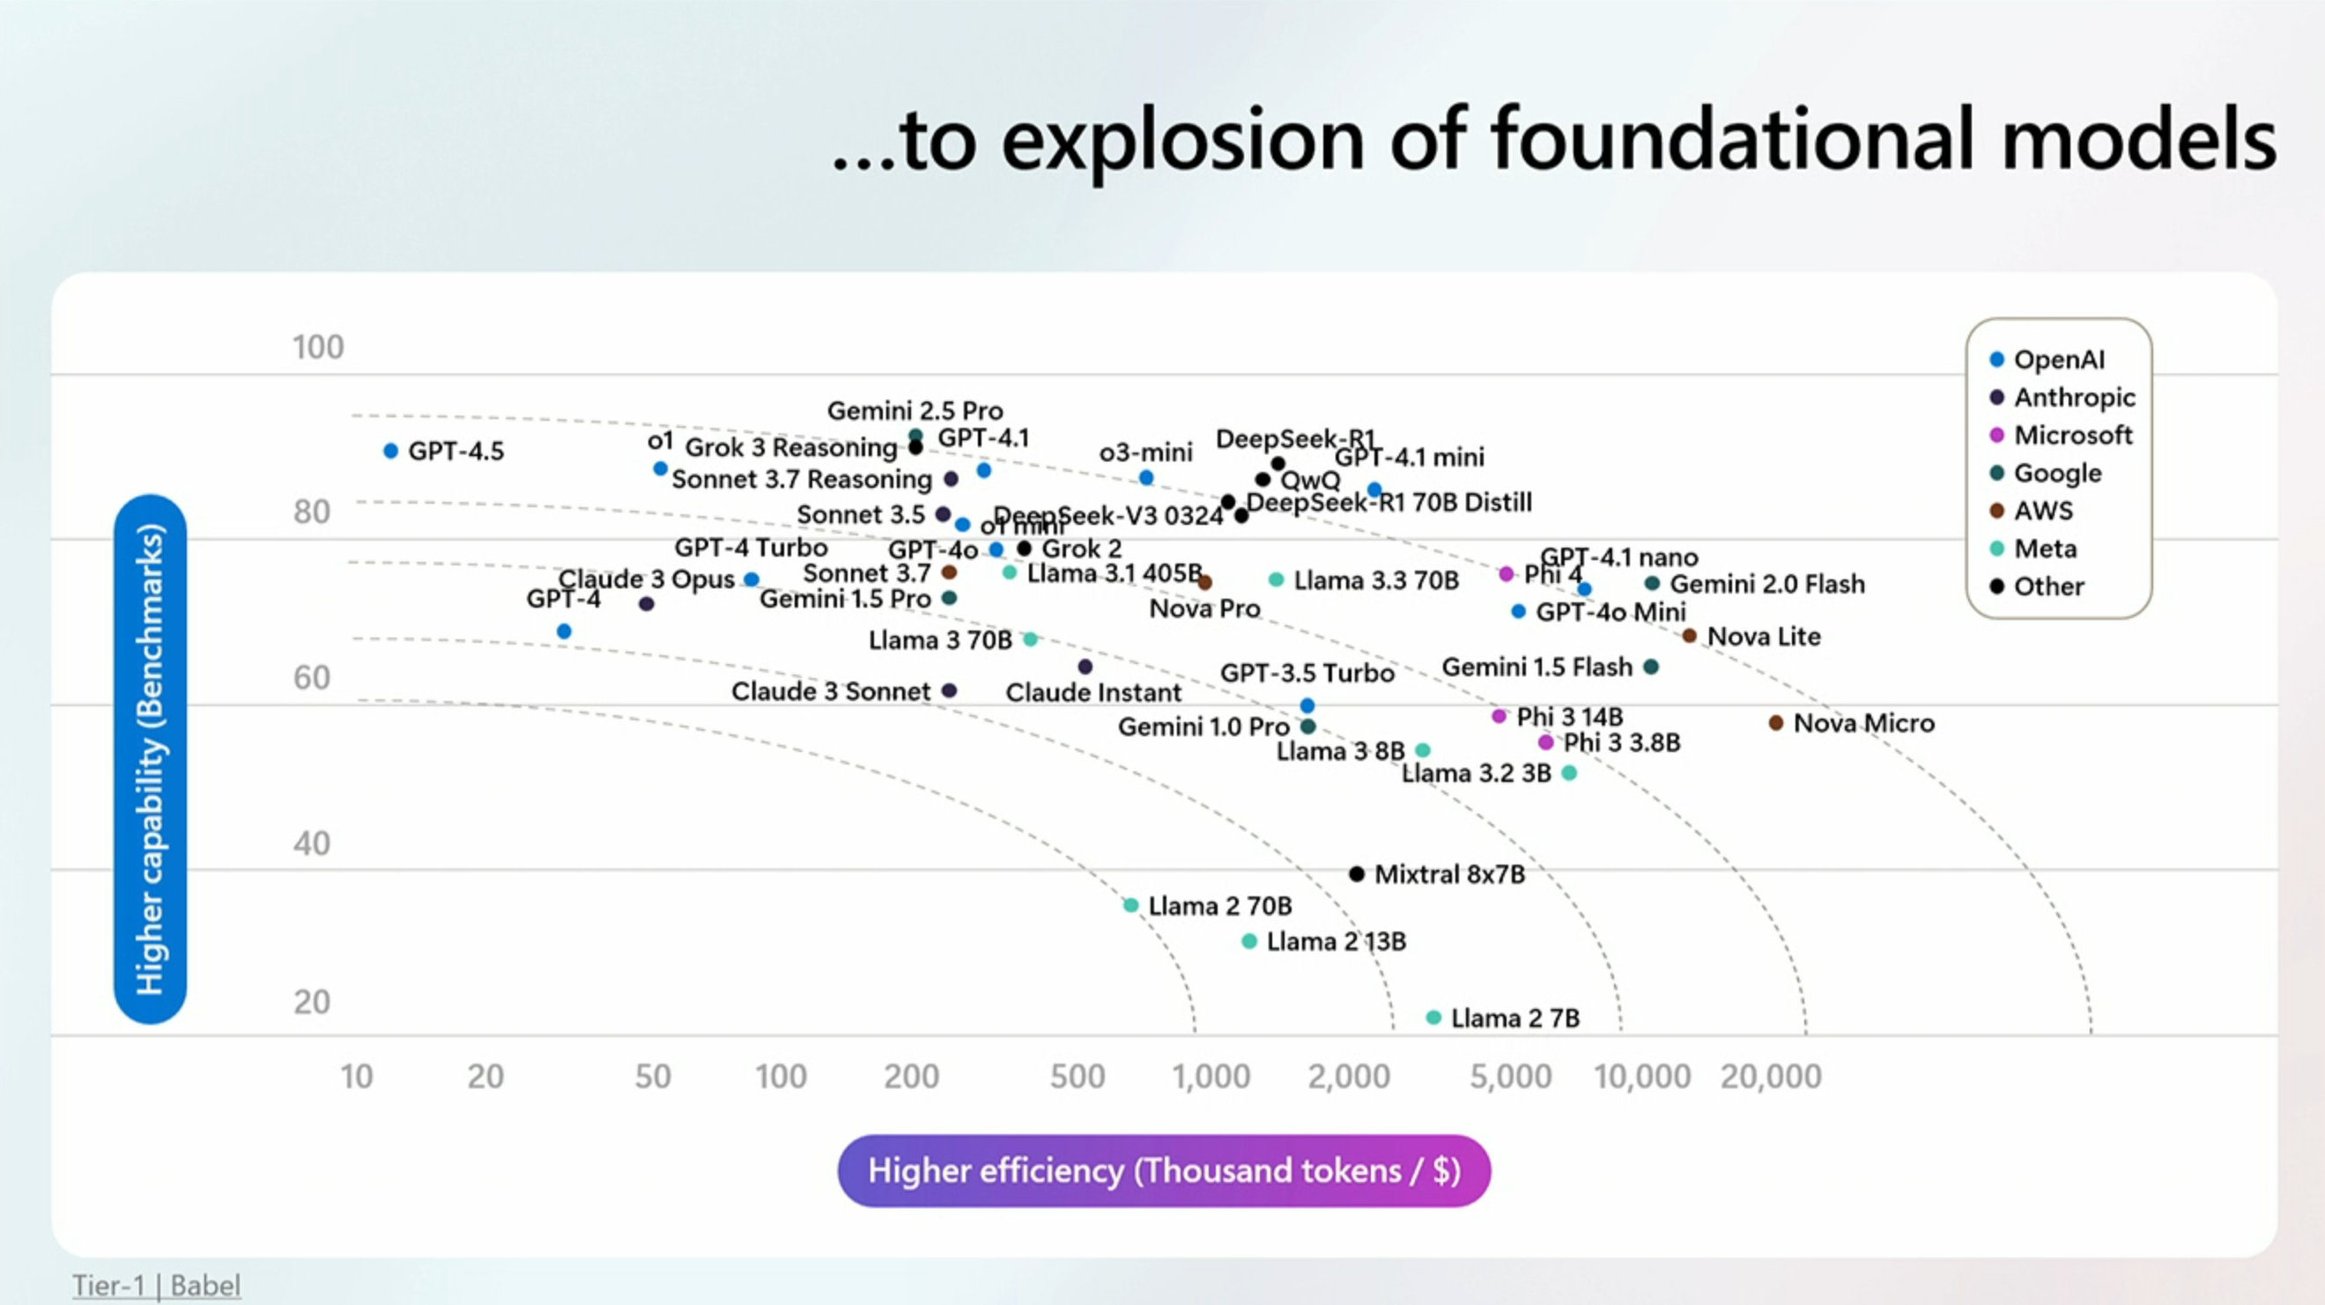

Slide 59
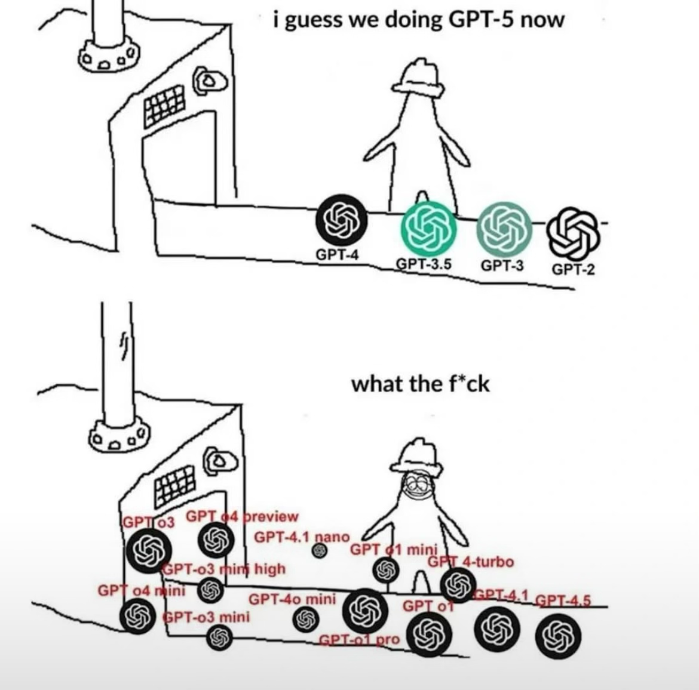

Slide 61
There’s more than one model
Don’t go top-down
Go bottom-up
Nano > mini > GPT > mini reasoning > reasoning
GPT 4.1-nano > GPT 4.1-mini (4o-mini) > GPT 4.1 (GPT 4o) > o4-mini (o3-mini, o1-mini) > o3 (o1)
https://openai.com/api/pricing/
https://github.com/marketplace/models

Slide 62
Step 6 – Try Different Models
https://github.com/tinestaric/AI4TestPlans/blob/main/Handout.md

Slide 63
Time | Topic | Format
08:00–09:00 | Registration & Coffee | Arrival, Setup
09:00–09:30 | Welcome + Why Test Plans Matter + Workshop Goals | Talk
09:30–10:00 | Step 1: Try Prompting on Your Own (Cold Prompt) | Hands-on
10:00–10:45 | Step 2: Add Structure to Your Prompt | Lecture + Hands-on
10:45–11:00 | ☕ Coffee Break – Is prompting easy or hard? | Free roam
11:00–11:30 | Step 3: Use System Prompt Generator | Tool Walkthrough
11:30–12:20 | Step 4 & 5: Peer Feedback (ATDD Lens) + Improve Prompt | Pair Exercise
12:20–13:20 | 🍽️ Lunch – How did peer feedback change your perspective? | Break
13:20–14:00 | Step 6: Try Different Models | Hands-on + Group Debrief
14:00–14:45 | Step 7: Prompt for Reasoning Models | Lecture + Prompting
14:45–15:00 | ☕ Coffee Break – Which models did you like best? | Stretch + Chat
15:00–15:45 | Step 8: Manual Pre/Postprocessing | Guided + Solo Work
15:45–16:30 | Step 9: Multi-Model Pre/Postprocessing – Build Your Pipeline | Build Time
16:30–17:00 | Wrap-up: Demos, Reflections, What's Next | Group Share + Closing

Slide 64
Reasoning models
1. Less Need to “Hold Its Hand”
2. More Value in Constraints, Less in Examples
3. Room for Open-Ended Tasks
4. Self-Improving Patterns

Slide 65
For reasoning, your updated checklist should be:
Instruction – What’s the goal?
Constraints – Format? Tone? Limits?
Preferences – What to prioritize?
Flexibility – Should the model strictly follow or make decisions?
Optional Revision Loop – Can it check or improve itself?

Slide 66
Transformed Prompt for Reasoning Models
You are an AI assistant that generates user-centric test scenarios based on a user story.
Your goal is to create a concise, clean test plan in CSV format that focuses entirely on user actions, avoids implementation details, and respects strict formatting and phrasing conventions.
Constraints:
• Do not use the following words (or any synonyms) in the Scenario: attempt, display, ensure, expect, observe, read, open, test, view, verify.
• Do not mention UI elements such as buttons, menus, icons, or controls.
• Do not use articles or demonstrative pronouns (e.g., a, an, the, this, that).
• The scenario must start with the exact action verb from the “I want to…” clause of the user story (e.g., "Import", "Sign").
• If the requirement implies alternatives (e.g., add, replace, delete), generate separate scenarios for each.
• Format scenario IDs as TC-US<Story#>-<Seq#> with ascending order.
• Use sentence-style casing and no punctuation at the end of scenario lines.
• Output should be CSV with ; delimiter and no blank lines.
Preferences:
• Clearly reflect both positive and negative user actions.
• Ensure scenario naming directly maps back to the goal of the user story.
Output Format:
Return a CSV with these columns:
Scenario ID;User Story Name;Scenario;Positive or negative
Optional revision loop:
Before finalizing, review your output for compliance with phrasing, casing, and ID format. If inconsistencies exist, revise automatically.

Slide 67
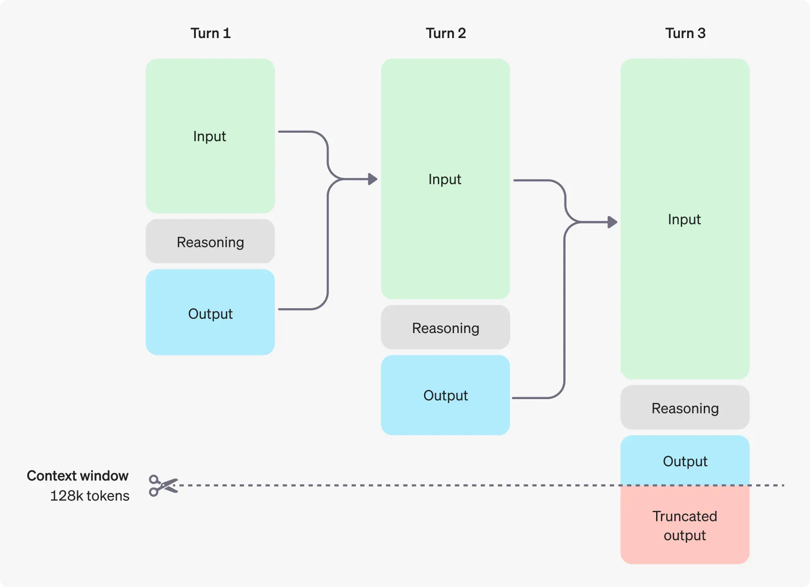

Slide 68
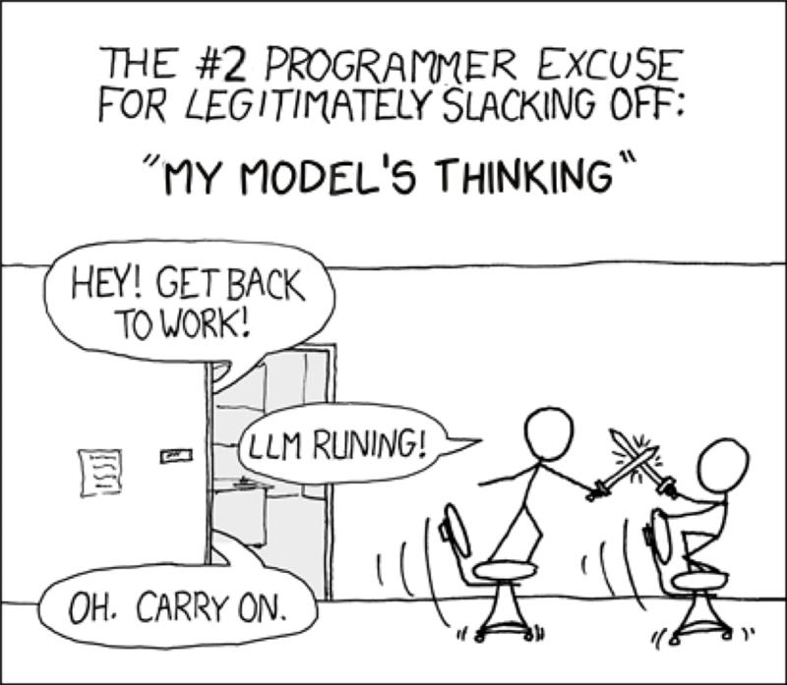

Slide 69
Step 7 – Prompt for Reasoning
https://github.com/tinestaric/AI4TestPlans/blob/main/Handout.md

Slide 70
Time | Topic | Format
08:00–09:00 | Registration & Coffee | Arrival, Setup
09:00–09:30 | Welcome + Why Test Plans Matter + Workshop Goals | Talk
09:30–10:00 | Step 1: Try Prompting on Your Own (Cold Prompt) | Hands-on
10:00–10:45 | Step 2: Add Structure to Your Prompt | Lecture + Hands-on
10:45–11:00 | ☕ Coffee Break – Is prompting easy or hard? | Free roam
11:00–11:30 | Step 3: Use System Prompt Generator | Tool Walkthrough
11:30–12:20 | Step 4 & 5: Peer Feedback (ATDD Lens) + Improve Prompt | Pair Exercise
12:20–13:20 | 🍽️ Lunch – How did peer feedback change your perspective? | Break
13:20–14:00 | Step 6: Try Different Models | Hands-on + Group Debrief
14:00–14:45 | Step 7: Prompt for Reasoning Models | Lecture + Prompting
14:45–15:00 | ☕ Coffee Break – Which models did you like best? | Stretch + Chat
15:00–15:45 | Step 8: Manual Pre/Postprocessing | Guided + Solo Work
15:45–16:30 | Step 9: Multi-Model Pre/Postprocessing – Build Your Pipeline | Build Time
16:30–17:00 | Wrap-up: Demos, Reflections, What's Next | Group Share + Closing

Slide 71
AI workflow
1
2
3
Pre-processing
AI-assisted task completion
Post-processing
… input
(user stories)
for better AI understanding
creating and exercising system prompt
and refining
… reviewing AI’s output with your expert knowledge
Notes:
How do we get AI to create TP?
What are the challenges in this?
Garbage in, garbage out
However, when content is sufficient, but format is "chaos" AI will clear that
Fine tune the prompt to get
TP/scenarios in right phrasing
TP in right format
Areas, id, prio, notes

Slide 72
Transformed Prompt for Reasoning Models
You are an AI assistant that generates user-centric test scenarios based on a user story.
Your goal is to create a concise, clean test plan in CSV format that focuses entirely on user actions, avoids implementation details, and respects strict formatting and phrasing conventions.
Constraints:
• Do not use the following words (or any synonyms) in the Scenario: attempt, display, ensure, expect, observe, read, open, test, view, verify.
• Do not mention UI elements such as buttons, menus, icons, or controls.
• Do not use articles or demonstrative pronouns (e.g., a, an, the, this, that).
• The scenario must start with the exact action verb from the “I want to…” clause of the user story (e.g., "Import", "Sign").
• If the requirement implies alternatives (e.g., add, replace, delete), generate separate scenarios for each.
• Format scenario IDs as TC-US<Story#>-<Seq#> with ascending order.
• Use sentence-style casing and no punctuation at the end of scenario lines.
• Output should be CSV with ; delimiter and no blank lines.
Preferences:
• Clearly reflect both positive and negative user actions.
• Ensure scenario naming directly maps back to the goal of the user story.
Output Format:
Return a CSV with these columns:
Scenario ID;User Story Name;Scenario;Positive or negative
Optional revision loop:
Before finalizing, review your output for compliance with phrasing, casing, and ID format. If inconsistencies exist, revise automatically.

Slide 73
Step 8 – Pre/Postprocess Manually
https://github.com/tinestaric/AI4TestPlans/blob/main/Handout.md

Slide 74
Time | Topic | Format
08:00–09:00 | Registration & Coffee | Arrival, Setup
09:00–09:30 | Welcome + Why Test Plans Matter + Workshop Goals | Talk
09:30–10:00 | Step 1: Try Prompting on Your Own (Cold Prompt) | Hands-on
10:00–10:45 | Step 2: Add Structure to Your Prompt | Lecture + Hands-on
10:45–11:00 | ☕ Coffee Break – Is prompting easy or hard? | Free roam
11:00–11:30 | Step 3: Use System Prompt Generator | Tool Walkthrough
11:30–12:20 | Step 4 & 5: Peer Feedback (ATDD Lens) + Improve Prompt | Pair Exercise
12:20–13:20 | 🍽️ Lunch – How did peer feedback change your perspective? | Break
13:20–14:00 | Step 6: Try Different Models | Hands-on + Group Debrief
14:00–14:45 | Step 7: Prompt for Reasoning Models | Lecture + Prompting
14:45–15:00 | ☕ Coffee Break – Which models did you like best? | Stretch + Chat
15:00–15:45 | Step 8: Manual Pre/Postprocessing | Guided + Solo Work
15:45–16:30 | Step 9: Multi-Model Pre/Postprocessing – Build Your Pipeline | Build Time
16:30–17:00 | Wrap-up: Demos, Reflections, What's Next | Group Share + Closing

Slide 75

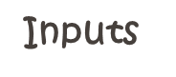


Prepare – Analyze – Review
Prepare
Analyze
Review
GPT 4.1 Mini
GPT 4.1
o3

Slide 76

The future of agentic swarms...
Create an exact replica of the image, don't change a thing.

Slide 77

The future of agentic swarms...
Create an exact replica of the image, don't change a thing.

Slide 78
Step 9 – Pre/Postprocess with Prompts and Models
https://github.com/tinestaric/AI4TestPlans/blob/main/Handout.md

Slide 79
Haiku Competition

Slide 80
Time | Topic | Format
08:00–09:00 | Registration & Coffee | Arrival, Setup
09:00–09:30 | Welcome + Why Test Plans Matter + Workshop Goals | Talk
09:30–10:00 | Step 1: Try Prompting on Your Own (Cold Prompt) | Hands-on
10:00–10:45 | Step 2: Add Structure to Your Prompt | Lecture + Hands-on
10:45–11:00 | ☕ Coffee Break – Is prompting easy or hard? | Free roam
11:00–11:30 | Step 3: Use System Prompt Generator | Tool Walkthrough
11:30–12:20 | Step 4 & 5: Peer Feedback (ATDD Lens) + Improve Prompt | Pair Exercise
12:20–13:20 | 🍽️ Lunch – How did peer feedback change your perspective? | Break
13:20–14:00 | Step 6: Try Different Models | Hands-on + Group Debrief
14:00–14:45 | Step 7: Prompt for Reasoning Models | Lecture + Prompting
14:45–15:00 | ☕ Coffee Break – Which models did you like best? | Stretch + Chat
15:00–15:45 | Step 8: Manual Pre/Postprocessing | Guided + Solo Work
15:45–16:30 | Step 9: Multi-Model Pre/Postprocessing – Build Your Pipeline | Build Time
16:30–17:00 | Wrap-up: Demos, Reflections, What's Next | Group Share + Closing

Slide 81
Wrap-Up

Slide 82
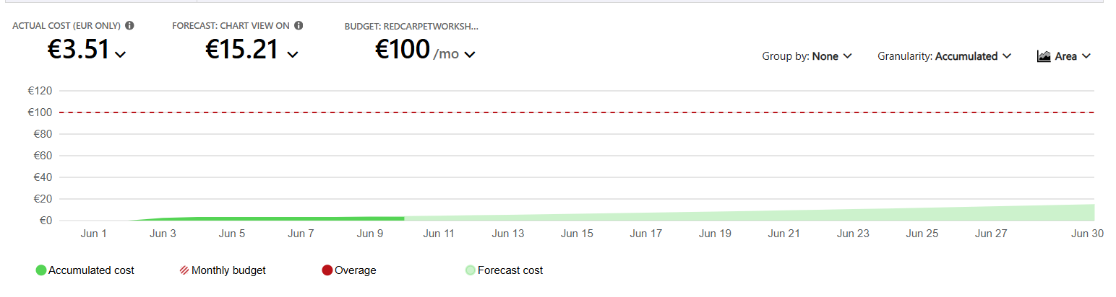
How much did all this cost?

Slide 83
This journey
How we started
Realizing the potential of a structured system prompt creation
The idea
Can AI turn requirements into test plans?
Initial approach
Throwing everything into AI (trial & error)
Key lesson
AI needs structured guidance

Slide 84
This journey
How we started
Realizing the potential of a structured system prompt creation
The idea
Can AI turn requirements into test plans?
Initial approach
Throwing everything into AI (trial & error)
Key lesson
AI needs structured guidance

Slide 85
This journey
How we started
Realizing the potential of a structured system prompt creation
The idea
Can AI turn requirements into test plans?
Initial approach
Throwing everything into AI (trial & error)
Key lesson
AI needs structured guidance

Slide 86
This journey
How we started
Realizing the potential of a structured system prompt creation
The idea
Can AI turn requirements into test plans?
Initial approach
Throwing everything into AI (trial & error)
Key lesson
AI needs structured guidance
Notes:
Demo in first steps with AI
Simple prompt (trial)
You should convert the user stories into a test plan.
Create first system prompt
The model should create a test plan for the requirements the user will paste in.
Usually user stories.
The test plan should be in lines that can be copied to an excel sheet.

Slide 87
Time | Topic | Format
08:00–09:00 | Registration & Coffee | Arrival, Setup
09:00–09:30 | Welcome + Why Test Plans Matter + Workshop Goals | Talk
09:30–10:00 | Step 1: Try Prompting on Your Own (Cold Prompt) | Hands-on
10:00–10:45 | Step 2: Add Structure to Your Prompt | Lecture + Hands-on
10:45–11:00 | ☕ Coffee Break – Is prompting easy or hard? | Free roam
11:00–11:30 | Step 3: Use System Prompt Generator | Tool Walkthrough
11:30–12:20 | Step 4 & 5: Peer Feedback (ATDD Lens) + Improve Prompt | Pair Exercise
12:20–13:20 | 🍽️ Lunch – How did peer feedback change your perspective? | Break
13:20–14:00 | Step 6: Try Different Models | Hands-on + Group Debrief
14:00–14:45 | Step 7: Prompt for Reasoning Models | Lecture + Prompting
14:45–15:00 | ☕ Coffee Break – Which models did you like best? | Stretch + Chat
15:00–15:45 | Step 8: Manual Pre/Postprocessing | Guided + Solo Work
15:45–16:30 | Step 9: Multi-Model Pre/Postprocessing – Build Your Pipeline | Build Time
16:30–17:00 | Wrap-up: Demos, Reflections, What's Next | Group Share + Closing

Slide 88
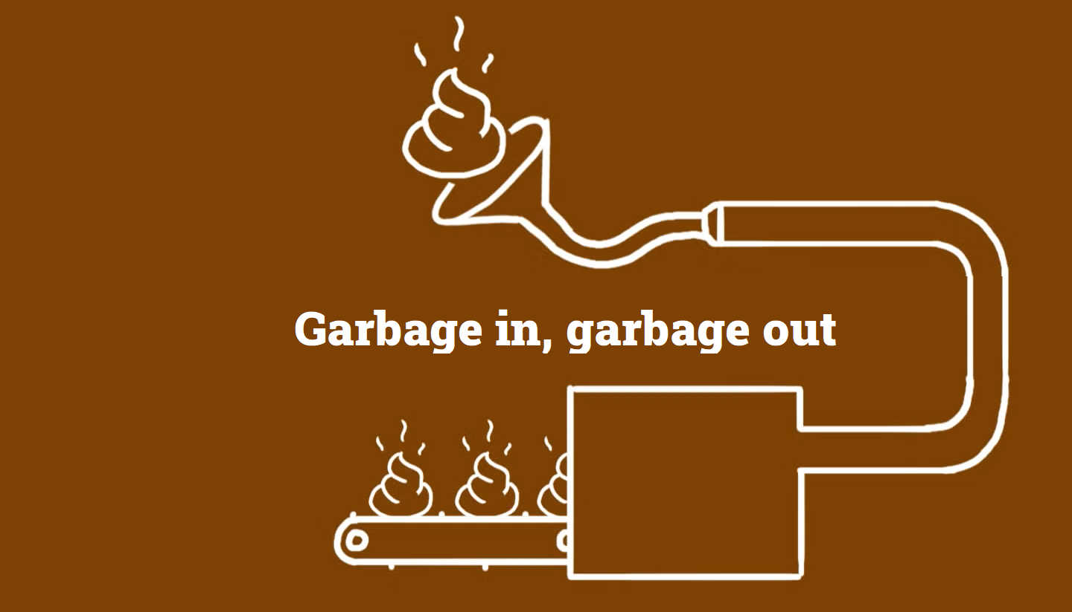
AI will not add content
However, when content is sufficient, but format is "chaos“, AI will be able to clear that
Notes:
How do we get AI to create TP?
What are the challenges in this?
Garbage in, garbage out
However, when content is sufficient, but format is "chaos" AI will clear that
Fine tune the prompt to get
TP/scenarios in right phrasing
TP in right format
Areas, id, prio, notes

Slide 89


Complete Garbage
Most Amazing things I’ve ever seen

Slide 90
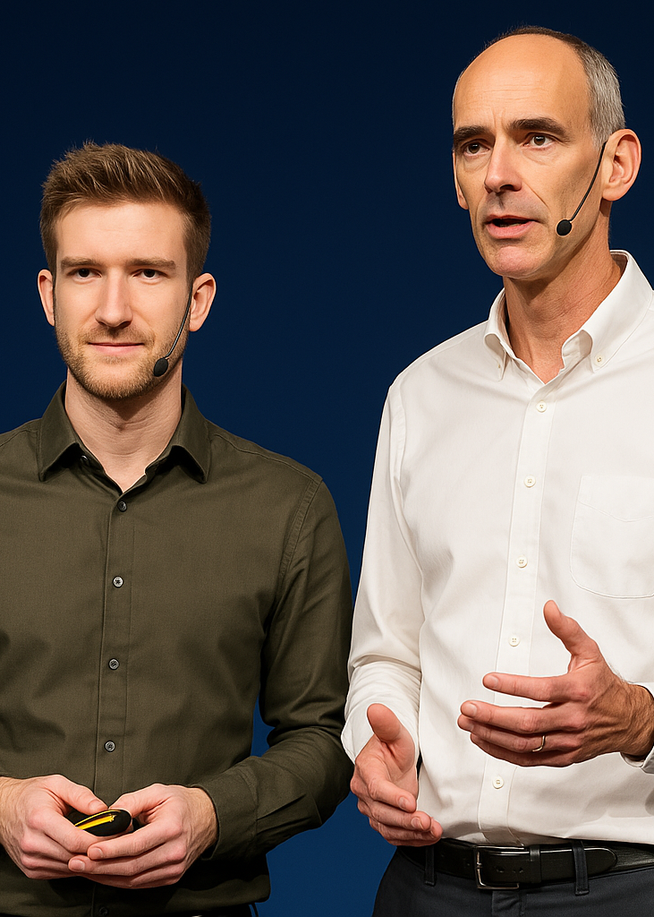
Wrap-Up
AI reduces manual effort in test planning
How to structure effective AI workflows
AI is a nice and patient companion to discuss with and get results with high speed
Given a good prompt and complete user stories I get a Test Plan in no time
YOU’RE WRONG!
That’s a good point

Slide 91
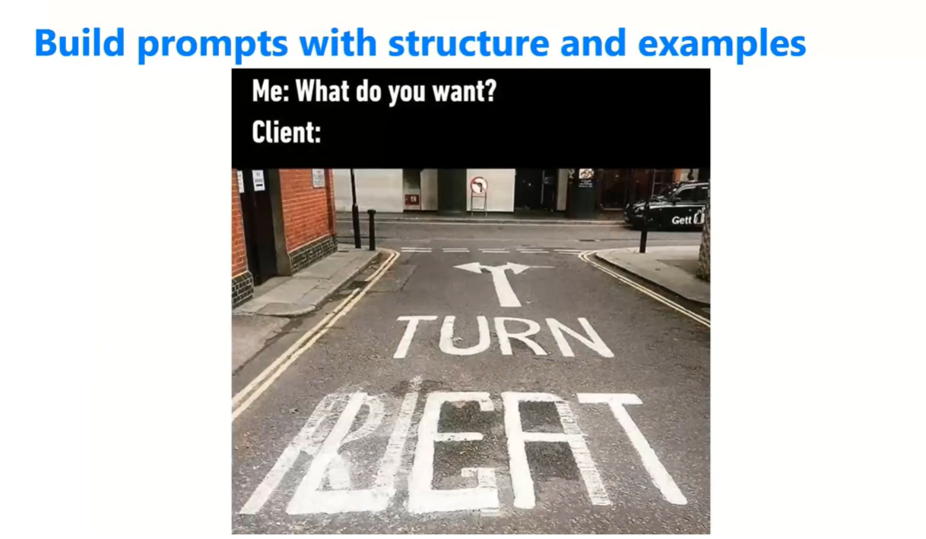
Find more on Prompt Engineering on Areopa Webinars
https://www.youtube.com/watch?v=q8xpDwjyNLY
Notes:
https://www.youtube.com/watch?v=q8xpDwjyNLY

Slide 92

Q & A

Slide 93

Thursday 2.00 PM

Slide 94

Friday 9.00 AM

Slide 95
